Slide 1
Chap#6
Requirements Modeling: Scenarios, Information, And Analysis Classes

Slide 2
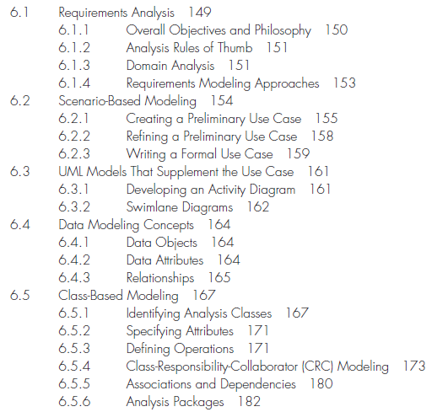

Slide 3
6.1 Requirements Analysis
Requirements analysis results in the specification of software’s operational characteristics, indicates software’s interface with other system elements, and establishes constraints that software must meet.
The requirements modeling action results in one or more of the following types of models:
• Scenario-based models of requirements from the point of view of various system “actors”
• Data models that depict the information domain for the problem
• Class-oriented models that represent object-oriented classes (attributes and operations) and the manner in which classes collaborate to achieve system requirements.
• Flow-oriented models that represent the functional elements of the system and how they transform data as it moves through the system
• Behavioral models that depict how the software behaves as a consequence of external “events”.
Figure 6.1

Slide 4
6.1.1 Overall Objectives and Philosophy
The requirements model must achieve three primary objectives:
(1) to describe what the customer requires,
(2) to establish a basis for the creation of a software design
(3) to define a set of requirements that can be validated once the software is built.

Slide 5
6.1.2 Analysis Rules of Thumb
• The model should focus on requirements that are visible within the problem or business domain. The level of abstraction should be relatively high.
• Each element of the requirements model should add to an overall understanding of software requirements and provide insight into the information domain, function, and behavior of the system.
• Delay consideration of infrastructure and other nonfunctional models until design.
• Minimize coupling throughout the system. It is important to represent relationships between classes and functions(overlapping less).
• Be certain that the requirements model provides value to all stakeholders.
• Keep the model as simple as it can be.

Slide 6
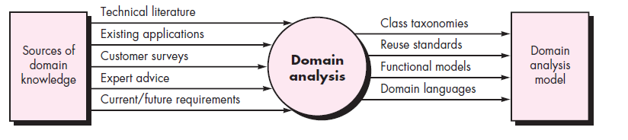
6.1.3 Domain Analysis
Domain analysis doesn’t look at a specific application, but rather at the domain in which the application resides. The intent is to identify common problem solving elements that are applicable to all applications within the domain.

Slide 7
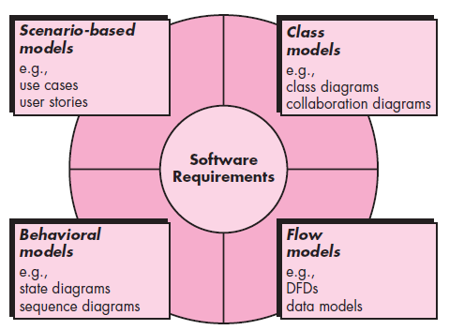
6.1.4 Requirements Modeling Approaches
One view of requirements modeling, called structured analysis, considers data and the processes that transform the data as separate entities. Data objects are modeled in a way that defines their attributes and relationships. Processes that manipulate data objects are modeled in a manner that shows how they transform data as data objects flow through the system.
A second approach to analysis modeling, called object-oriented analysis, focuses on the definition of classes and the manner in which they collaborate with one another to effect customer requirements.
Notes:
Scenario-based elements depict how the user interacts with the system and the specific sequence of activities that occur as the software is used.
Class-based elements model the objects that the system will manipulate, the operations that will be applied to the objects to effect the manipulation, relationships between the objects, and the collaborations that occur between the classes that are defined.
Behavioral elements depict how external events change the state of the system or the classes that reside within it.
Flow-oriented elements represent the system as an information transform, depicting how data objects are transformed as they flow through various system functions.

Slide 8
6.2 SCENARIO-BASED MODELING
User satisfaction resides at the top of the list.
Requirements modeling with UML begins with the creation of scenarios in the form of use cases, activity diagrams, and swim lane diagrams.
6.2.1 Creating a Preliminary Use Case
But how do you know (1) what to write about, (2) how much to write about it, (3) how detailed to make your description, and (4) how to organize the description? These are the questions that must be answered if use cases are to provide value as a requirements modeling tool.
What to write about? The first two requirements engineering tasks—inception and elicitation.

Slide 9
Continue…
6.2.2 Refining a Preliminary Use Case
A description of alternative interactions is essential for a complete understanding of the function that is being described by a use case. Answers to these questions result in the creation of a set of secondary scenarios that are part of the original use case but represent alternative behavior.
6.2.3 Writing a Formal Use Case
Use case involves a critical activity or describes a complex set of steps with a significant number of exceptions, a more formal approach may be desirable(precondition, trigger(start, end), scenario, Exceptions).
Fig 6.4

Slide 10
6.3 UML MODELS THAT SUPPLEMENT THE USE CASE
6.3.1 Developing an Activity Diagram
The UML activity diagram supplements the use case by providing a graphical representation of the flow of interaction within a specific scenario. Similar to the flowchart.
Fig 6.5
6.3.2 Swim lane Diagrams
The UML swim lane diagram is a useful variation of the activity diagram and allows you to represent the flow of activities described by the use case and at the same time indicate which actor.
Responsibilities are represented as parallel segments that divide the diagram vertically.

Slide 11
6.4 DATA MODELING CONCEPTS
If software requirements include the need to create, extend, or interface with a database or if complex data structures must be constructed and manipulated, the software team may choose to create a data model as part of overall requirements modeling.
The entity-relationship diagram (ERD) addresses these issues and represents all data objects that are entered, stored, transformed, and produced within an application.
6.4.1 Data Objects
A data object is a representation of composite information(attributes) that must be understood by software.
6.4.2 Data Attributes
Data attributes define the properties of a data object and take on one of three different characteristics. They can be used to (1) name an instance of the data object, (2) describe the instance, or (3) make reference to another instance in another table.
6.4.3 Relationships
Data objects are connected to one another in different ways.

Slide 12
6.5 Class-Based Modeling
Class-based modeling represents the objects that the system will manipulate, the operations (also called methods or services) that will be applied to the objects to effect the manipulation, relationships (some hierarchical) between the objects, and the collaborations that occur between the classes that are defined.
The elements of a class-based model include classes and objects, attributes, operations, class responsibility-collaborator (CRC) models, collaboration diagrams, and packages.

Slide 13
6.5.1 Identifying Analysis Classes
Identify classes by examining the usage scenarios developed as
part of the requirements model and performing a “grammatical parse” (rules) on the use cases developed for the system to be built.
Classes are determined by underlining each noun or noun phrase and entering it into a simple table.
Analysis classes manifest (External entities, Things, Occurrences or events, Roles, Organizational units, Places, Structures)
Potential class selection ways (Retained information, Needed services, Multiple attributes, Common attributes, Common operations, Essential requirements)

Slide 14
6.5.2 Specifying Attributes
Attributes that define the class—that clarify what is meant by the class in the context of the problem space.
you should study each use case and select those “things” that reasonably “belong” to the class.
Constitute a reasonable list of attributes.

Slide 15
6.5.3 Defining Operations
Operations define the behavior of an object. Although many different types of operations exist.
four broad categories: (1) operations that manipulate data in some way (e.g., adding, deleting, reformatting, selecting), (2) operations that perform a computation, (3) operations that inquire about the state of an object, and (4) operations that monitor an object for the occurrence of a controlling event.

Slide 16
6.5.4 Class-Responsibility-Collaborator (CRC) Modeling
Class-responsibility-collaborator (CRC) modeling provides a simple means for identifying and organizing the classes that are relevant to system or product requirements.
A CRC model is really a collection of standard index cards that represent classes. The cards are divided into three sections. Along the top of the card you write the name of the class. In the body of the card you list the class responsibilities on the left(relevant for the class) and the collaborators on the right(information needed to complete a responsibility)[Details from book].

Slide 17
6.5.5 Associations and Dependencies
In many instances, two analysis classes are related to one another in some fashion , much like two data objects may be related to one another. In UML these relationships are called associations.
In such cases, a client class depends on the server class in some way and a dependency relationship is established. Dependencies are defined by a stereotype. A stereotype is an “extensibility mechanism” within UML that allows you to define a special modeling element whose semantics are custom defined. In UML stereotypes are represented in double angle brackets.

Slide 18
6.5.6 Analysis Packages
Various elements of the analysis model (e.g., use cases, analysis classes) are categorized in a manner that packages them as a grouping—called an analysis package.
The plus sign preceding the analysis class name in each package indicates that the classes have public visibility and are therefore accessible from other packages.
A minus sign indicates that an element is hidden from all other packages and a # symbol indicates that an element is accessible only to packages contained within a given package.

